Slide 1
Virtual Enrollment Process
Notes:
Welcome to the Columbus City Schools Introduction to the Virtual Enrollment Process.

Slide 2
Virtual Enrollment Process
Complete Enrollment from the comfort of your own home or anywhere there is internet service.
Notes:
WHAT IS A VIRTUAL ENROLLMENT APPOINTMENT?
The Columbus City Schools virtual enrollment appointment allows Columbus City Schools staff and families, regardless of their location, to use technology to connect online, with video and audio, in real-time. This removes the need for families to physically attend an enrollment meeting at the Central Enrollment Center. Virtual meetings are held professionally and confidentially, just as they would be if families physically came to the Enrollment Center.

Slide 3
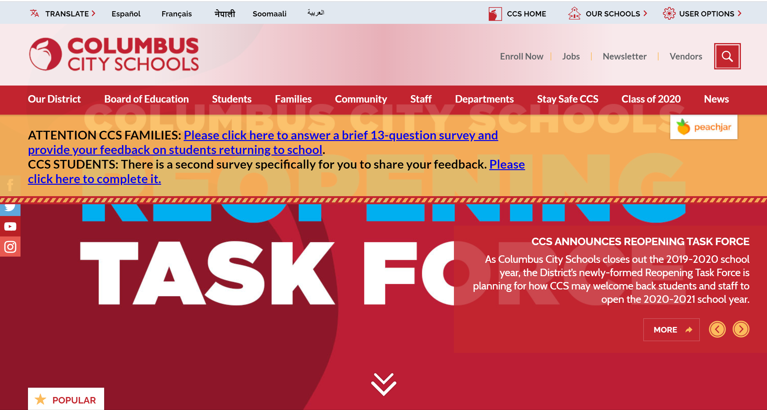
Notes:
Families new to Columbus City Schools, or re-enrolling back into Columbus City Schools, will need to enroll using the CCS Online Registration and schedule an enrollment appointment. The main page of the Columbus City Schools' website is where Parents/Guardians can find the Online Registration to begin the enrollment process. The "Enroll Now" heading, located on the main page of the website, will guide families to the Online Registration portal. Located with the "Enroll Now" page are instructions and a series of menu tabs that list various CCS Enrollment options.

Slide 4
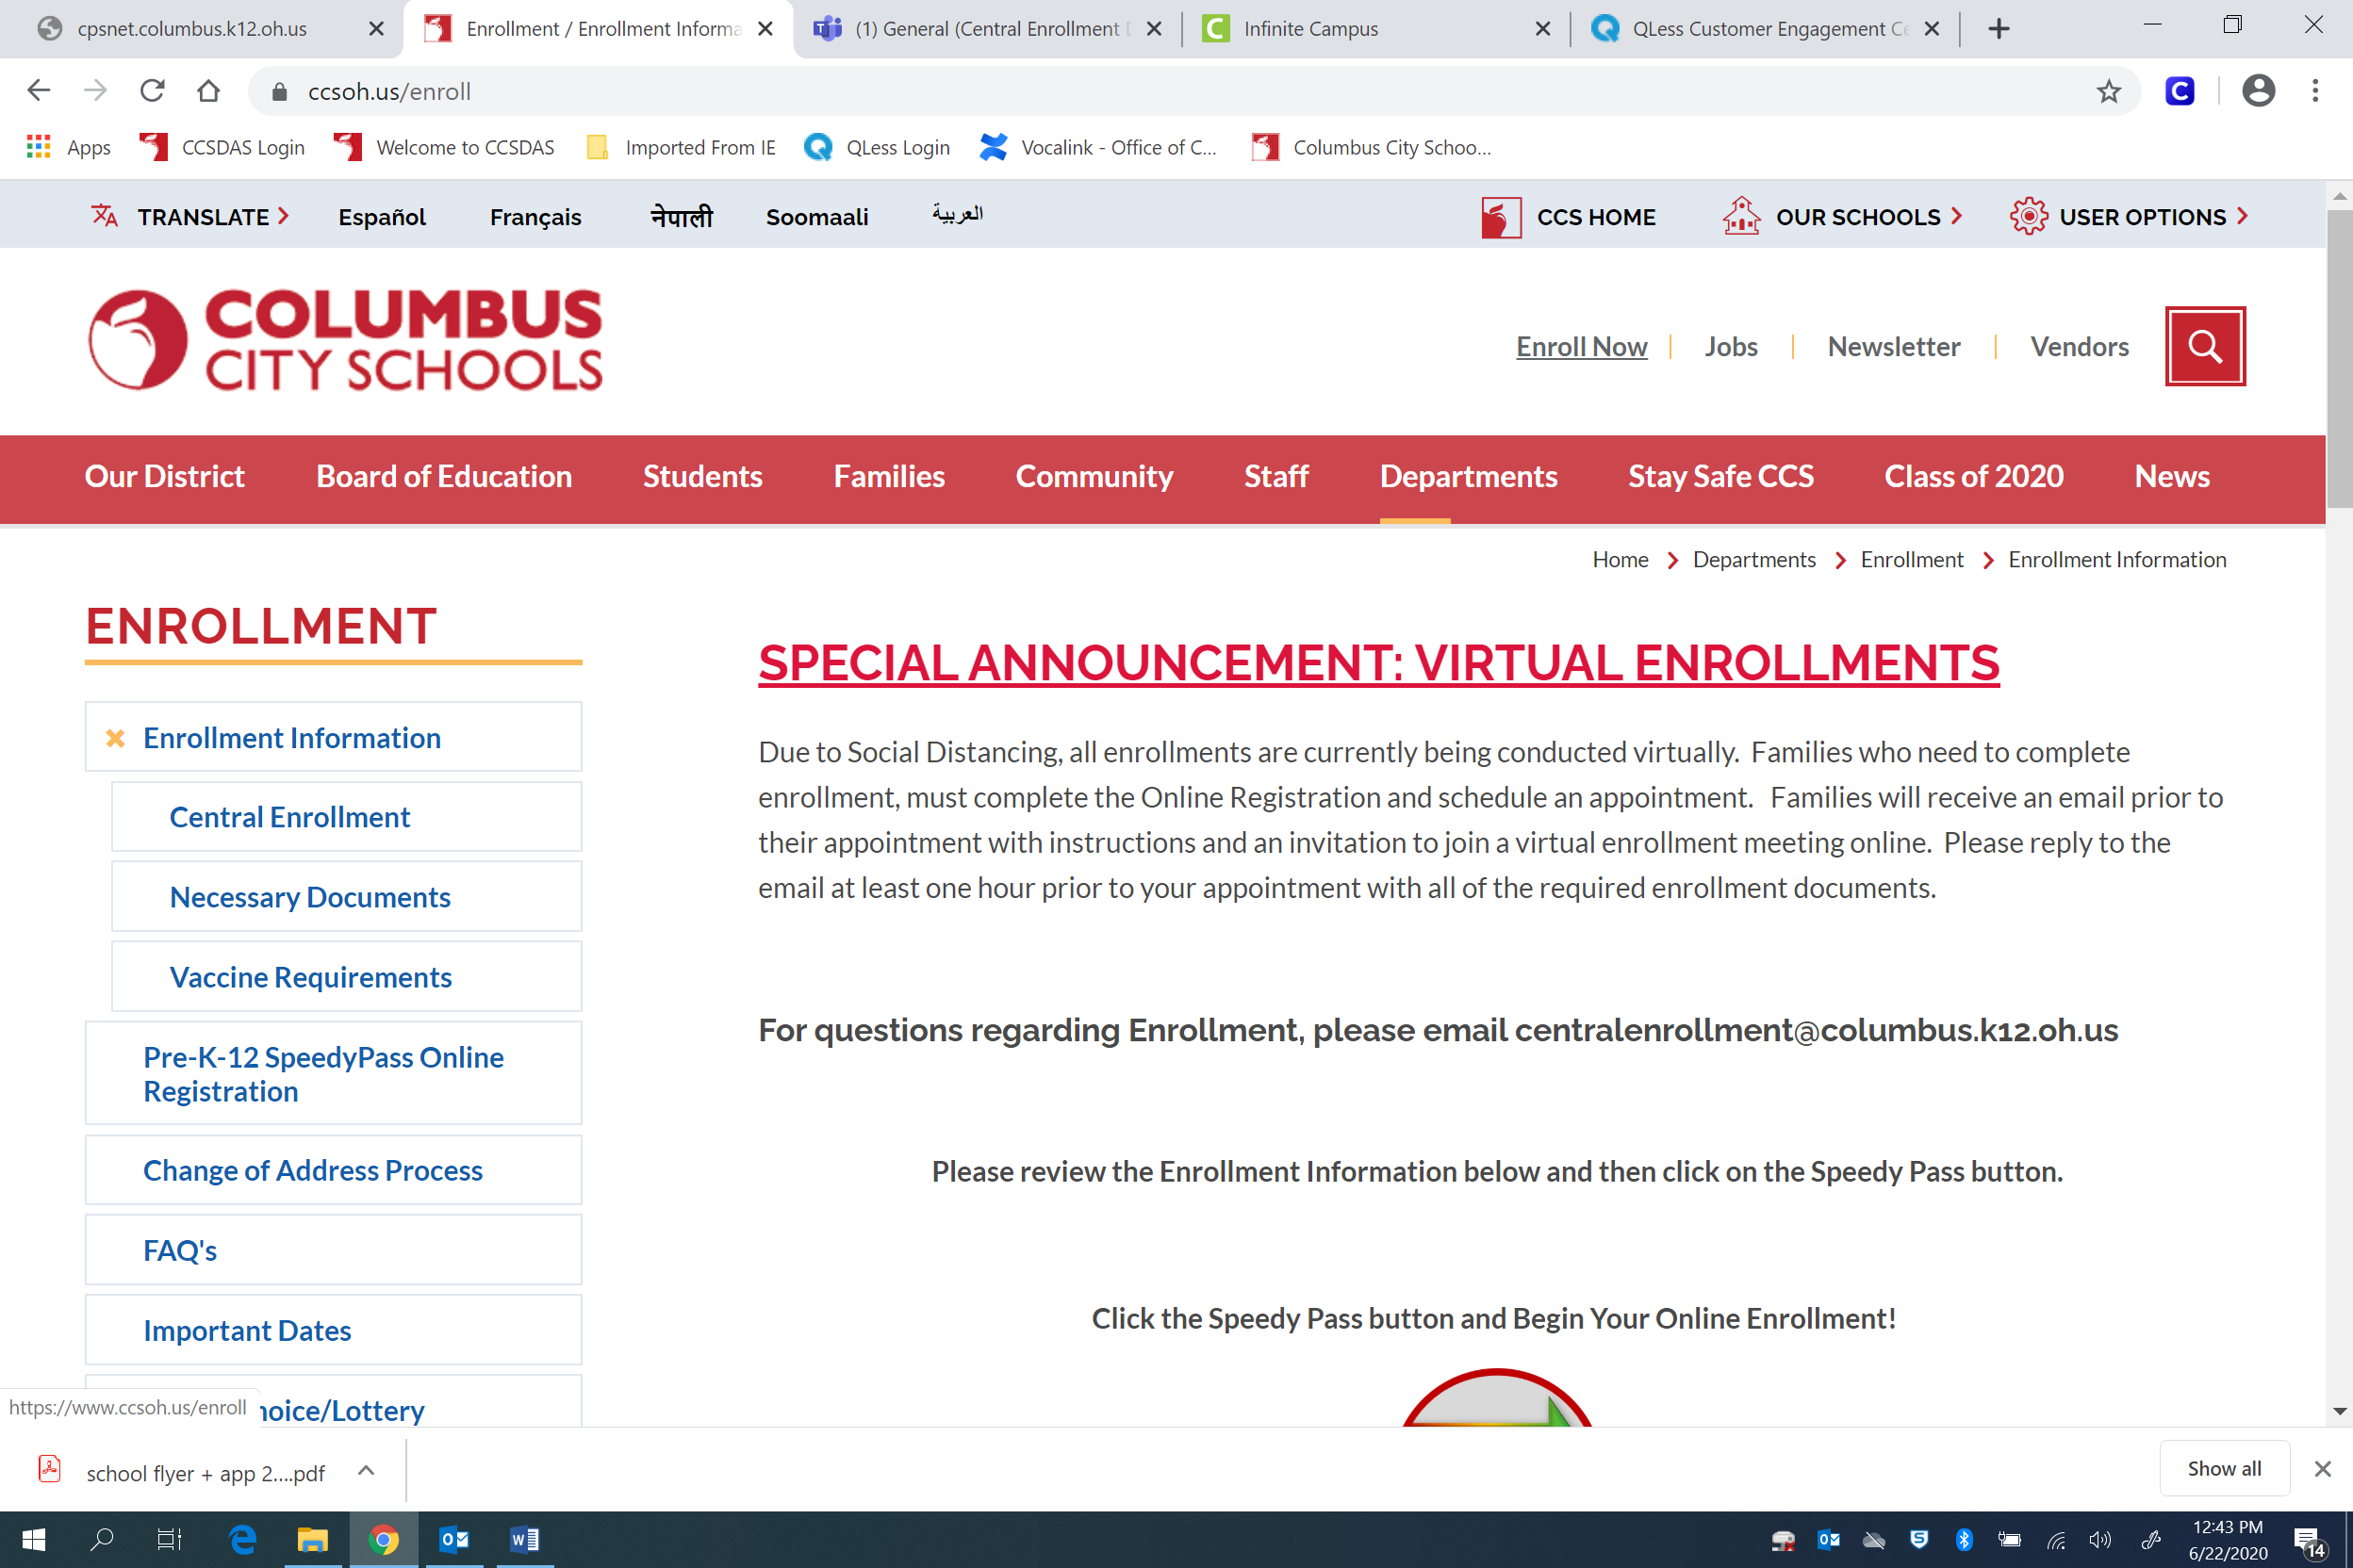
Notes:
Once the "Enroll Now" heading is selected, the Enrollment Page opens and contains important enrollment information. Detailed instructions about Columbus City Schools enrollment procedures are also provided. Applicants are encouraged to review and explore the information contained on the enrollment page to become familiar with enrollment processes and to access the Online Registration Portal.

Slide 5
Notes:
After reviewing the information provided about enrollment, click the Speedy Pass button to begin registration.

Slide 6
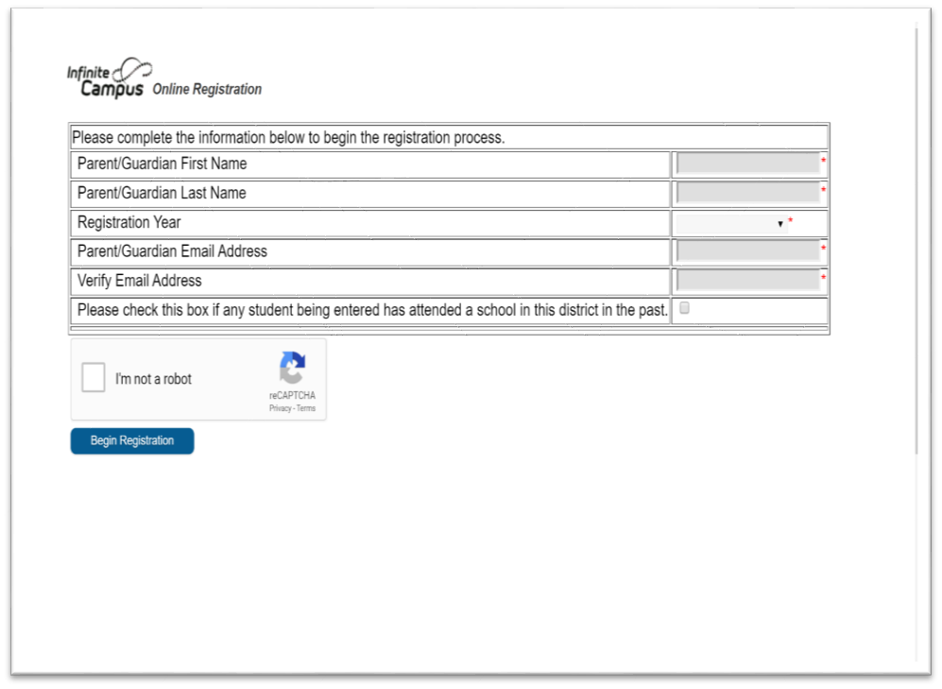
Notes:
You will be asked a few questions and must provide an email address.

Slide 7
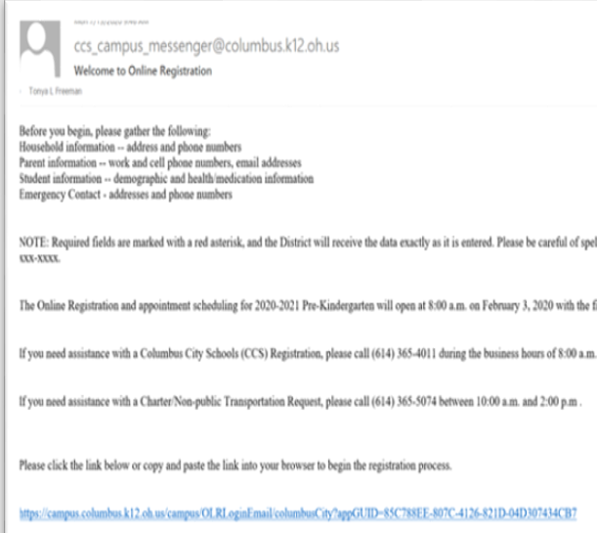
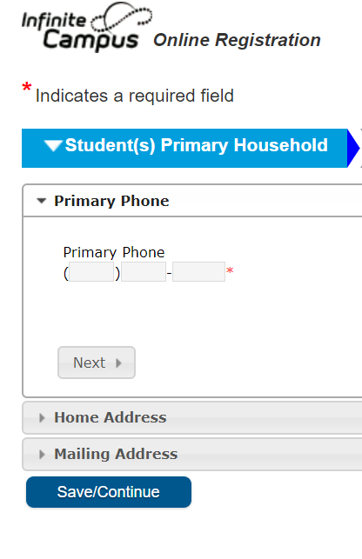
Notes:
The system will then send you a verification email with a link to log into to complete registration. You will navigate through a series of pages where you will be asked demographic information about your household.

Slide 8
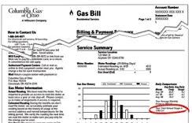
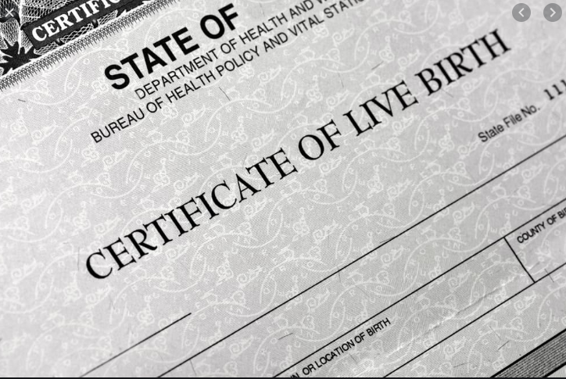
Notes:
While completing the Online Registration, the required enrollment documents must be uploaded within the Online Registration application.

Slide 9
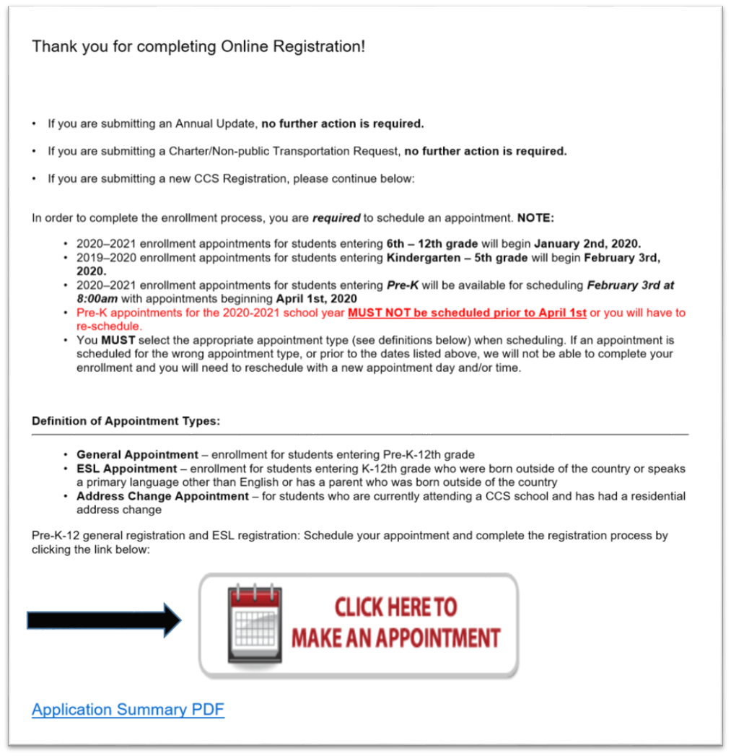
Notes:
The last page of the Online Registration, has a button that says Click Here to Make an Appointment. Once you click that button it will take you to the program to schedule your virtual appointment.

Slide 10
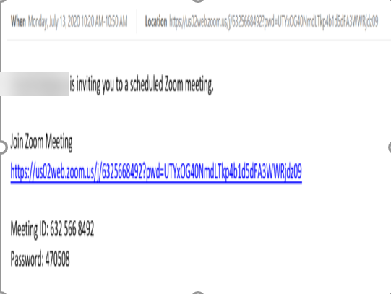
Notes:
You will receive an email before your appointment with a link to join the meeting virtually. The email may also request additional documentation be sent prior to your meeting.
At the time of your scheduled enrollment appointment, log in to your virtual meeting

Slide 11
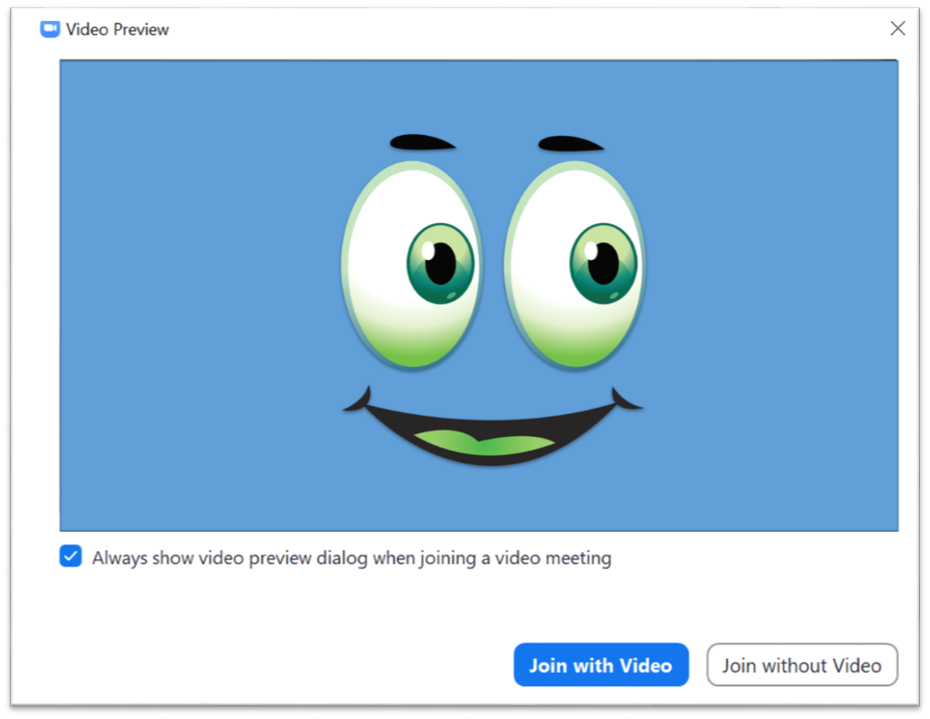
Notes:
The system will ask you to join with video

Slide 12
Notes:
and then it will ask you to join with audio.

Slide 13
Notes:
You may be placed in a virtual waiting room if you join early or while the Enrollment Specialist finishes with their previous customer. The Enrollment Specialist will then admit you to the appointment.

Slide 14
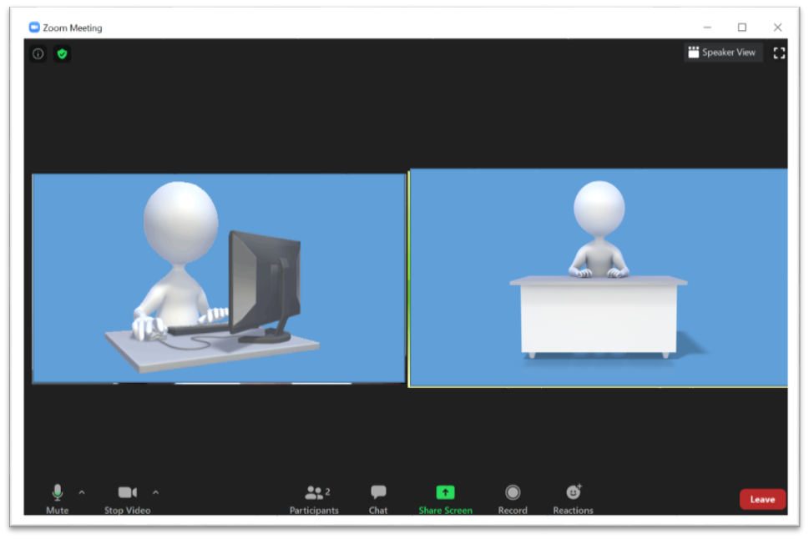
Notes:
During the virtual enrollment meeting, the enrollment specialist will:
Review the submitted Online Registration with parent/guardian
Verify the required enrollment documents
Thoroughly discuss Columbus City Schools enrollment processes
Enroll the student(s) into a Columbus City School.
Answer any additional questions the parent/guardian may have.

Slide 15
THANK YOU FOR TAKING THE TIME TO VISIT AND TOUR THE COLUMBUS CITY SCHOOLS’ VIRTUAL ENROLLMENT SITE

